Slide 1
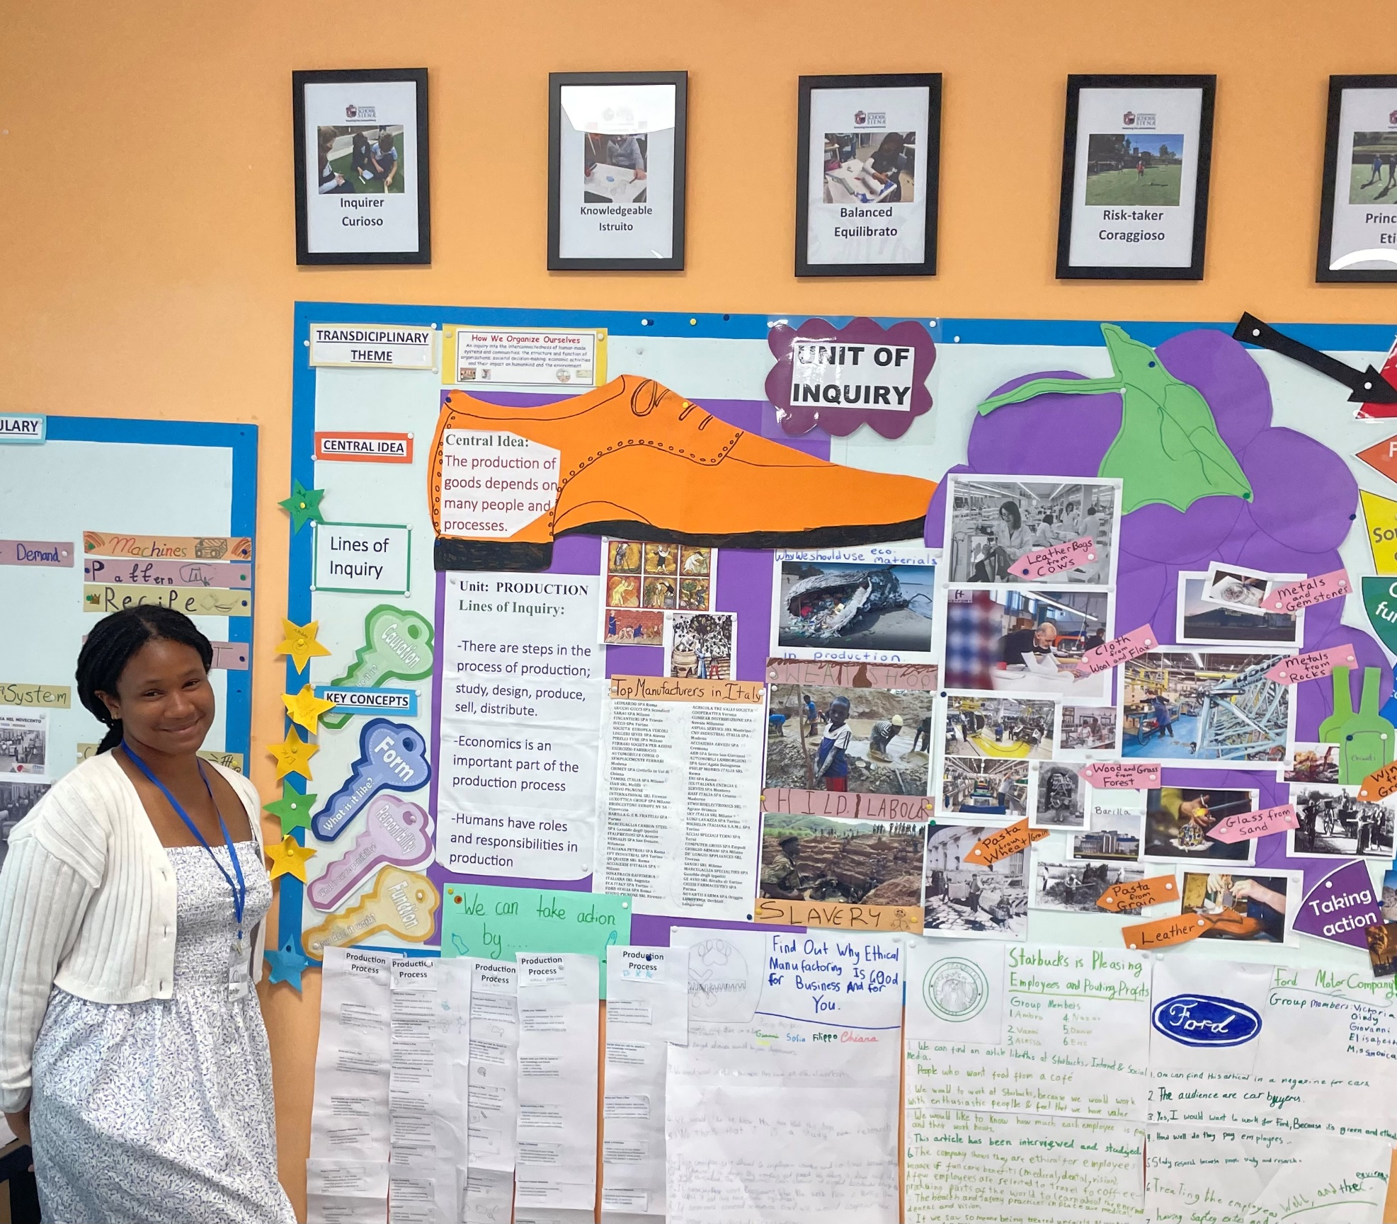
Teaching History at an International School with a culturally diverse student body
Orianne Simon, Early Childhood Education · Dr. Kerry Renzoni, Associate Professor of Music
Abstract
Method
To collect the data, I had analyzed how teachers taught history with a student body with diverse backgrounds and what are their experiences have been. I was looking for evidence and precautions that teachers and administrators take to teach an applicable curriculum.
Interpretations of Findings
In Siena Italy, my peers and I did research that was conducted in and outside of The International School of Siena. To expand our teaching careers and experiences. My research focused on how teachers teach history curriculum in international schools, where diversity has a significant impact since students travel from all over the world to gain an education. The role of the IB International education is significant in my research to understand how a diverse student body alters the teaching of history and how the curriculum ensures inclusivity for all students without compromising their educational experience.
Student teaching at the International School of Siena, I had the opportunity to interview my mentor teacher. I inquired if Monica would share her insights on teaching history to a diverse student body. She explained that teaching history in an international school requires acknowledging and embracing that diversity exist in the classroom. And that it should be celebrated. Miss. Monica would display this by singing “Happy Birthday in the student's native language, Italian and in English. It was inspiring to see the students be excited to engage in each others' cultures.
During my time at the International School of Siena, I taught a primary class. In grade 5, the curriculum included a Unit of Inquiry that integrated the student's history. The focus was on production, and we discussed the differences between unethical and ethical workspaces, as well as the operations of factories in various countries. The concept of fair trade was introduced, emphasizing the importance of being aware of the origins of purchased goods. Fair trade is a global movement to improve the lives of farmers in developing countries. It was inspiring to witness the students. Engagement; they eagerly shared fair-trade products and food from their own homes.
This picture is of me standing next to the production wall. The wall has pictures of child labor and unethical workspaces in different countries. The picture also has the main productions that Italy is known for. (leather shoes, wine, pasta etc.)
Background
What inspired me to do my research on History was because there is a real value to teaching history in the classroom. Learning from past mistakes, being able to build knowledge and a better understanding will help us appreciate the roots and causes of society’s sources. It will also build empathy towards other which can help us navigate the complexity of the world we live in. Having a classroom that is diverse creates more opportunities for students to learn more about their classmates' history and even their families' experiences. Creating this dynamic of endless learning of history.
Research in professional literature suggests that teaching history involves more than just dates; it is about making connections between past event and their impact on the present and the future. It is also crucial to foster an understanding of empathy and to develop critical thinking skills, according to “How to Teach History in a Culturally Responsive way.” (Cutler, 2023). This article also discuss to teaching history empathetically to foster a profound understanding of the complexities involved in interpreting the past. This approach allows teachers to involve students in meaningful learning experiences.
Conclusions
Teachers will be able to bring light to what is constantly going on in the world. Keep learning about one another through history. We as teachers can guide our students to how we approach people with different cultures who have had past conflicts resolved.
Findings
According to the International Baccalaureate for the Diploma Program (DP), structures its history courses around pivotal historical events, encompassing political, economic, social, and cultural aspects. Students learn to think historically and develop skills that enhance their understanding of history. A significant aspect of the IB curriculum is the ability to compare instances from various world regions, which cultivates a broad- minded approach in students. The IB curriculum offers history at the standard level and the higher level as well.
In my research, I discovered that much of my professional literature corresponded with my observations at Siena international School. My mentor teacher exemplified the teaching of empathy in the classroom by guiding students through a simulation of a workspace lacking ethical laws. This exercise enabled students to grasp the frustration of unfair treatment. They embodied the experience and then reflected mentally. Subsequently, they articulated their perceptions of ethical and unethical scenarios encountered during the activity, thereby integrating empathy into historical education.
Acknowledgements
Thank you to Buffalo State University and the wonderful professors that helped guide me through this experience. Thank you to Buffalo State International Education Conference for the Financial support while continuing my education.
References
(History in the DP - International Baccalaureate® (ibo.org)
History in Diploma Program- International baccalaureate
Cutler, D. (2023 June 8).. How to Teach History in a Culturally Responsive way.
Malinowski, H.W. & Zorn, Vera. (1973). The United Nations International school: it’s history and development. United Nations International School.

