Slide 1
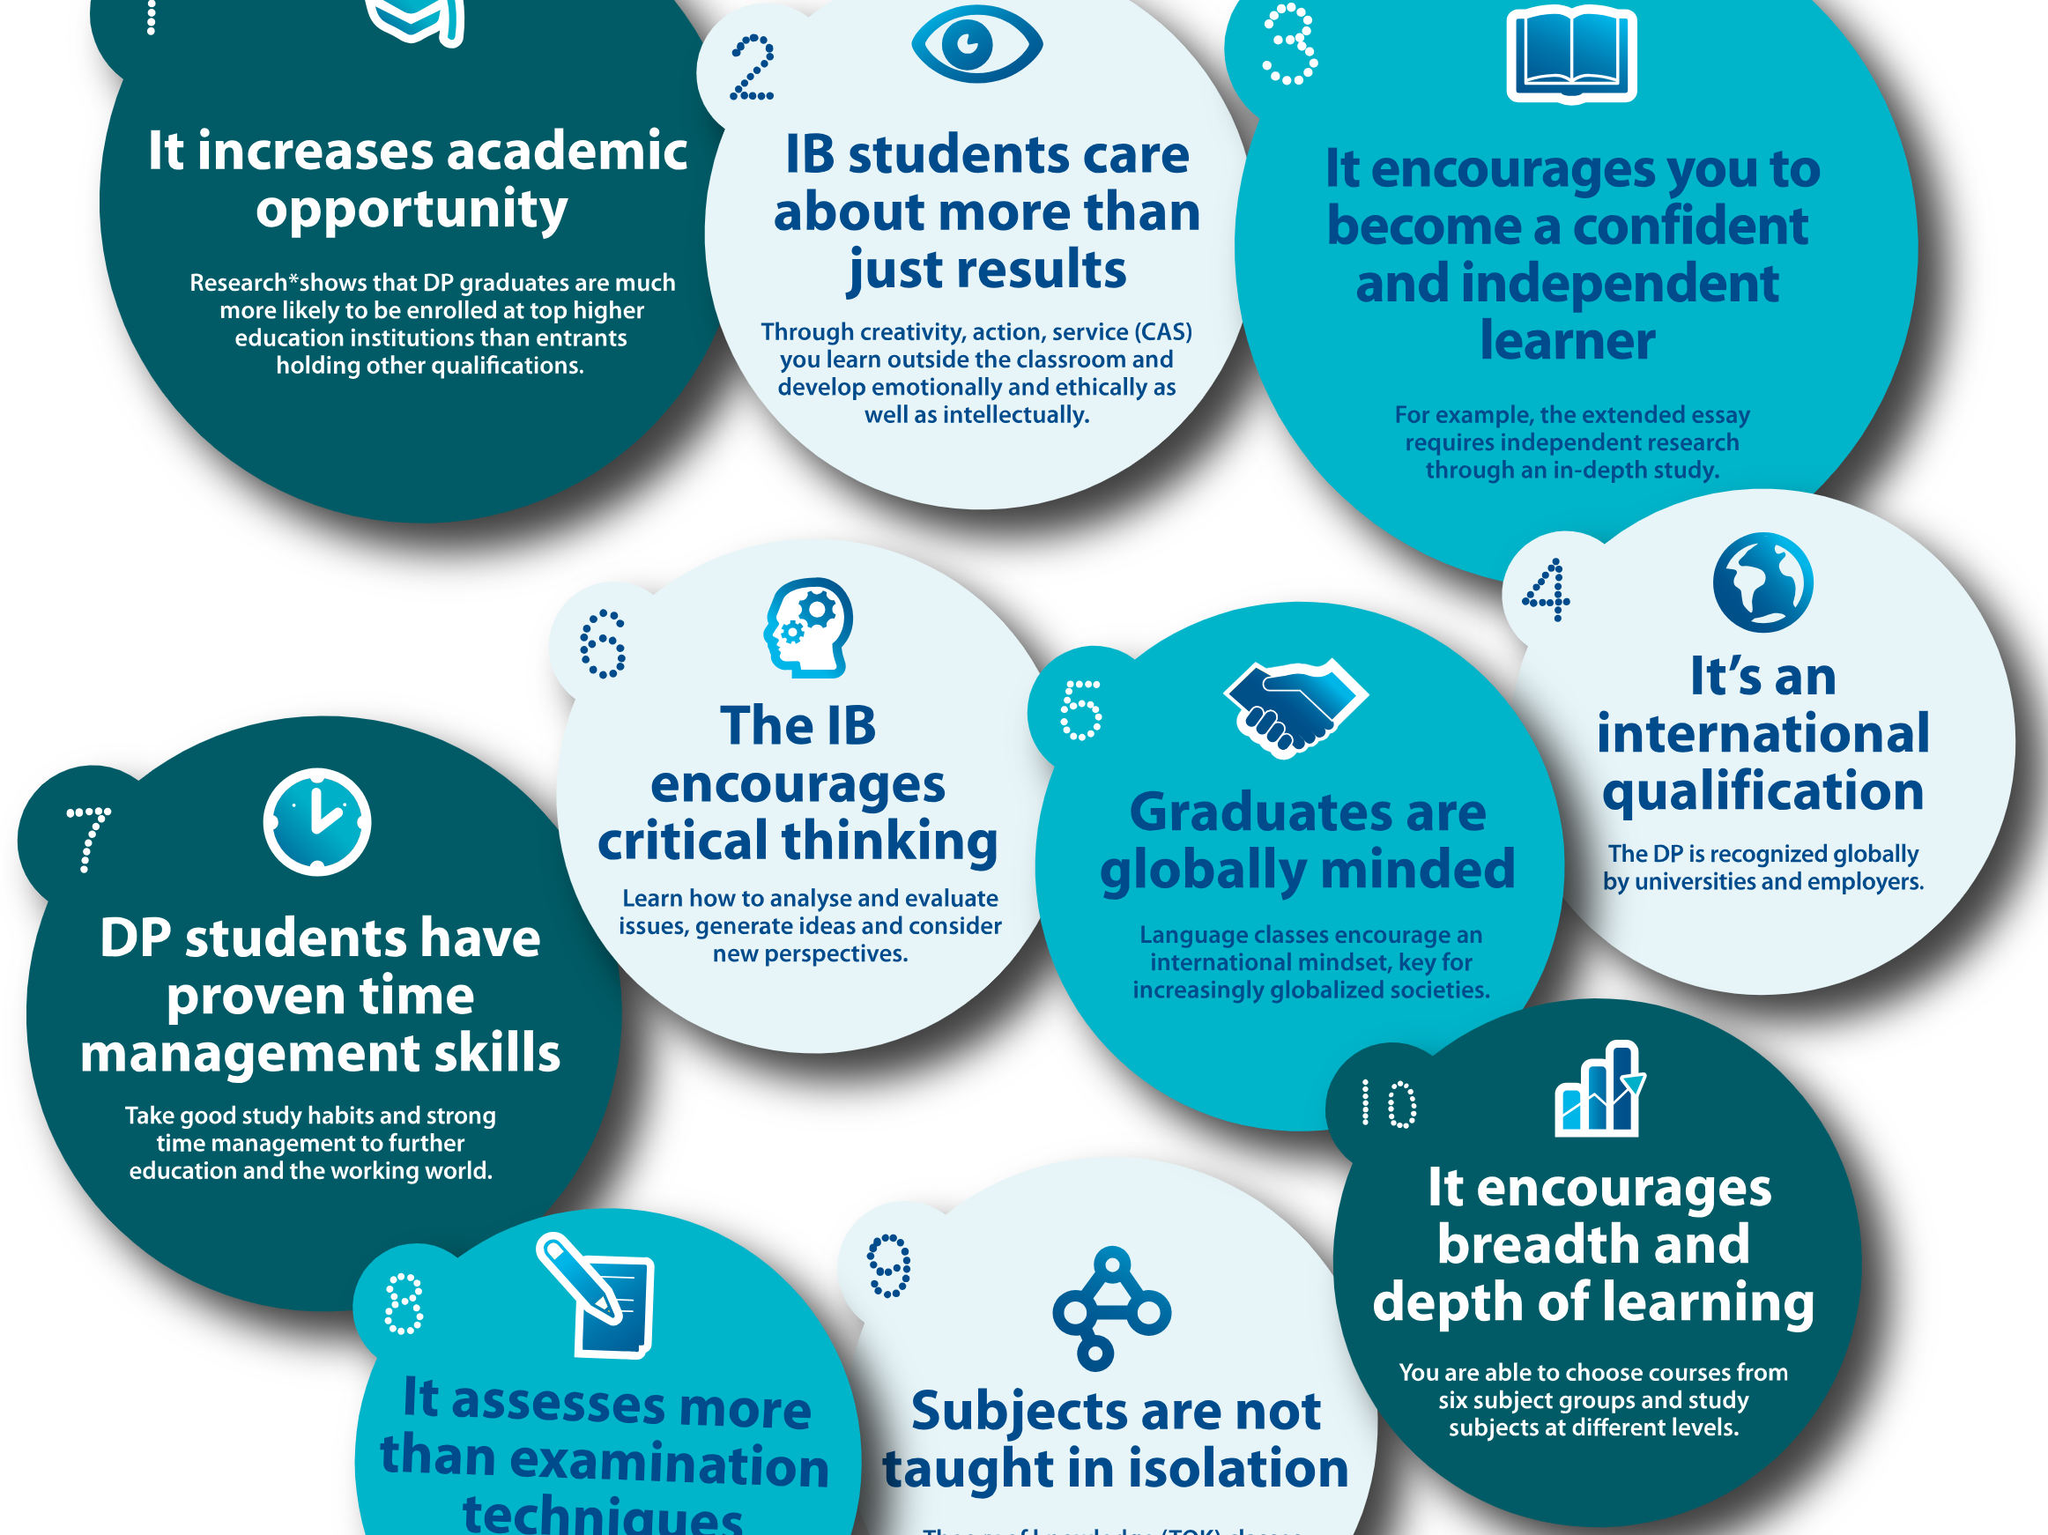
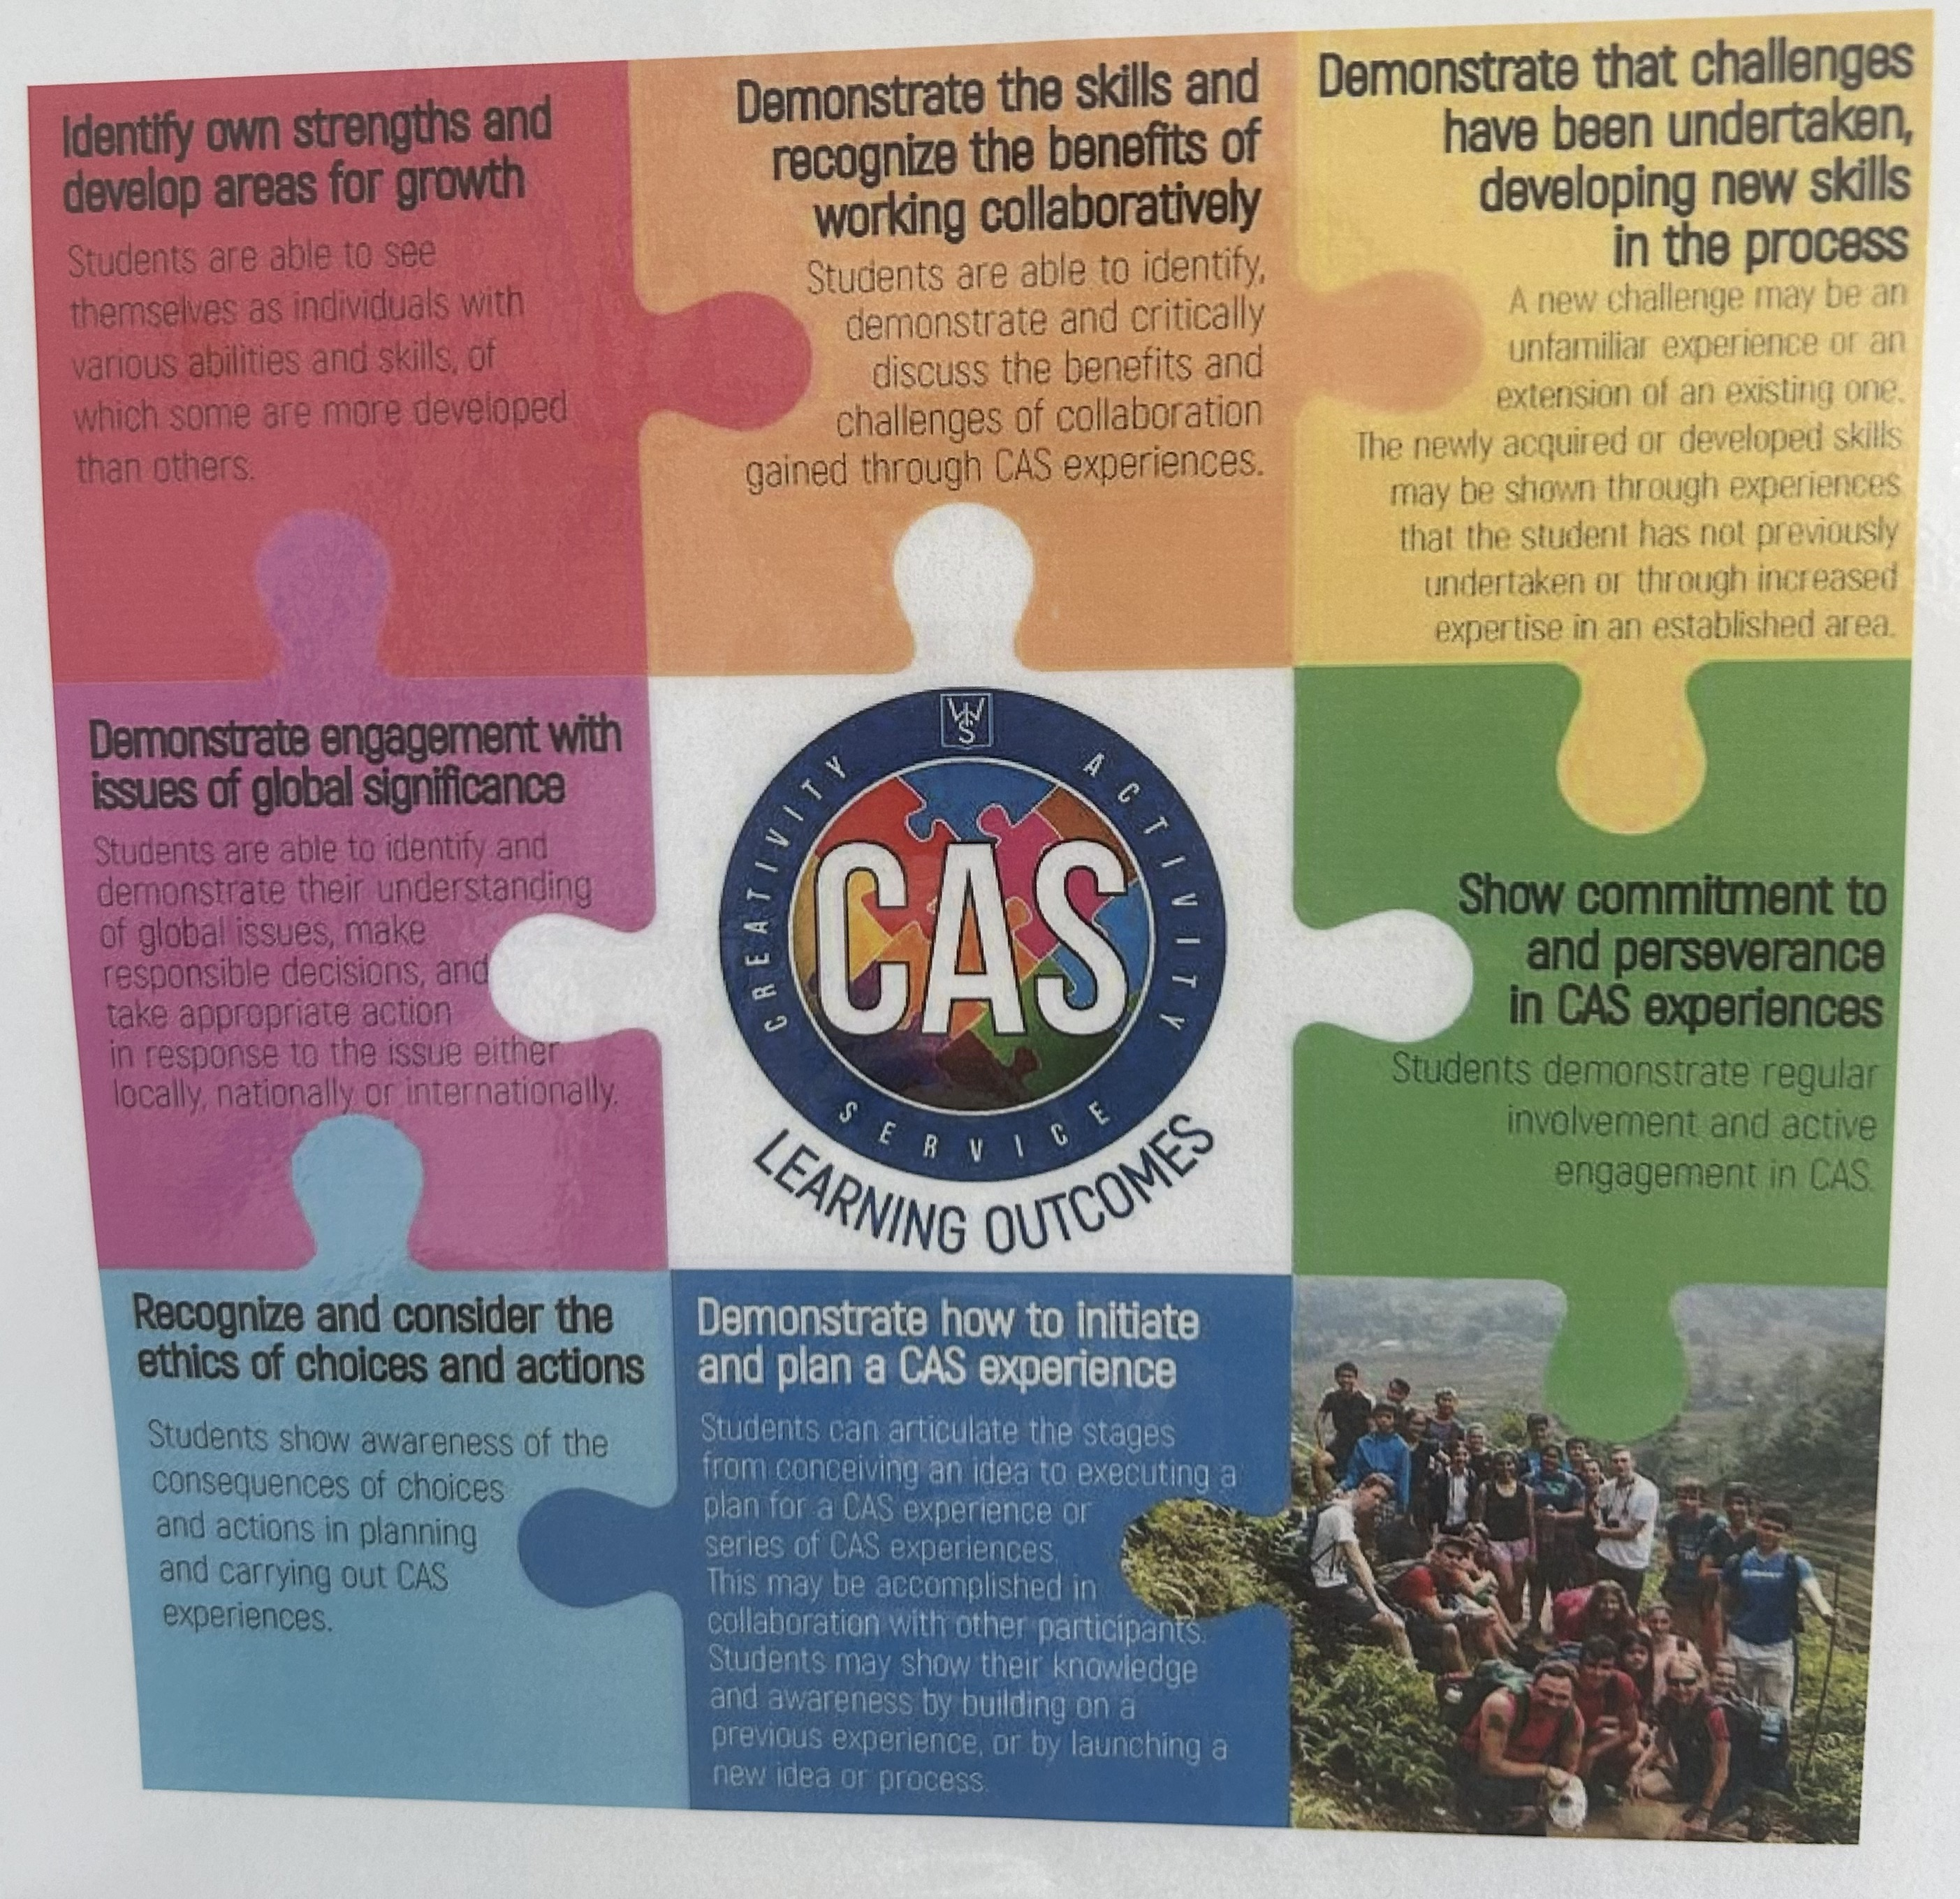
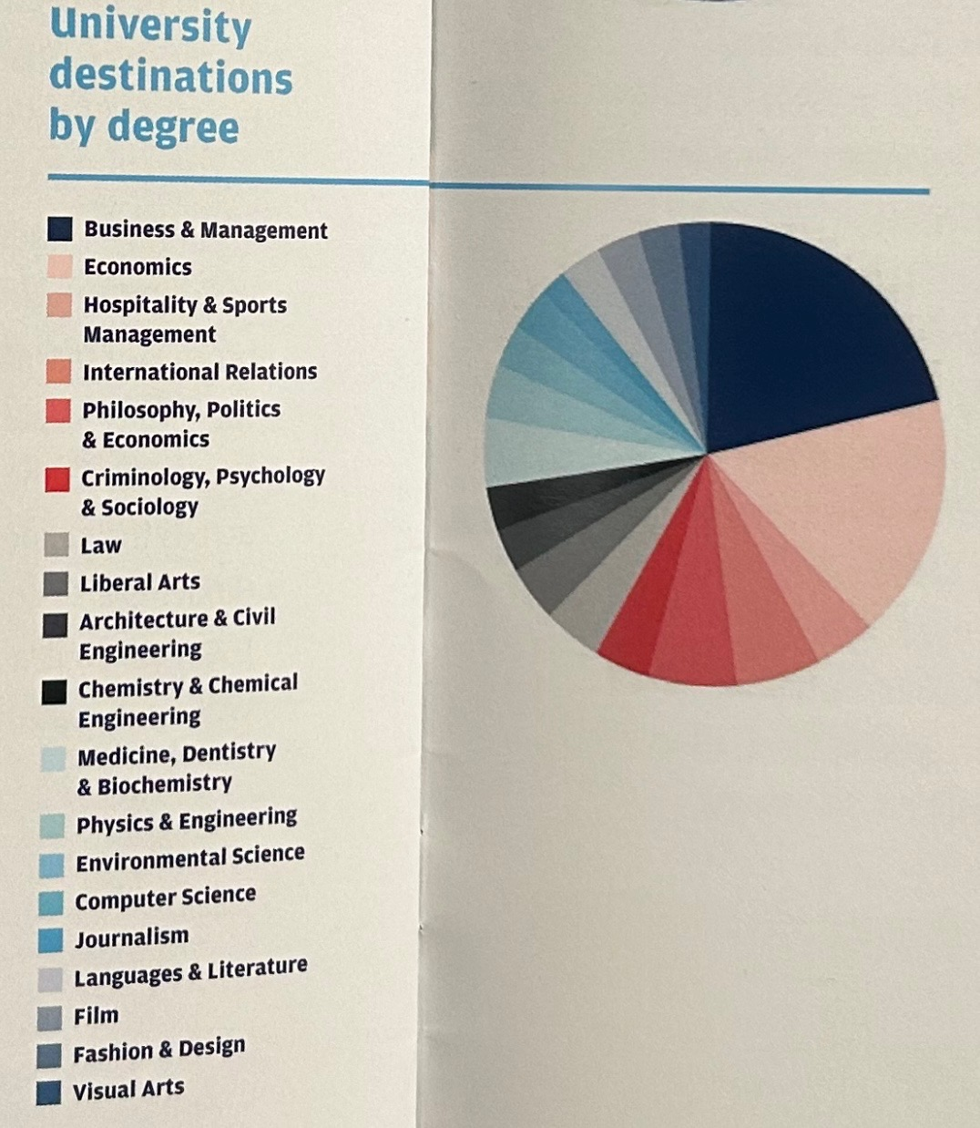
Career Exploration Opportunities for DP Students
Kelsey Chubb, Business Marketing Education · Dr. Kerry Renzoni, Associate Professor of Undergraduate Music Education
Abstract
Figures from the International School of Siena
Findings
10 reasons why the DP is ideal preparation for university ibo.org
Through field observations, informal interviews with economics and individuals and societies teachers, and working with the Middle Years Program as well, I found that the DP is strictly for high achieving and disciplined students. Each individual student can tailor their courses to learn content relevant to their career interests. Due to the IB cross-curriculum courses, students are exposed to different career options starting in primary school. The DP students have a clear course of action towards what they want to pursue career wise as individuals, then commit to a university and are accepted based upon their IB scores.
The business studies course work in the DP was very different compared to what is taught to business students in America. Students in Grade 12 were learning high-level aspects of business ownership, marketing, finance, and accounts. The students were pursuing a future in entrepreneurship. However, in American Public Schools, Introduction to Business or Career Financial Management is the first class offered to students. This class teaches majority of 9th graders first coming into high school about the business world and how to prepare for it. Career clusters are discussed, students learn how to write resumes, cover letters, and complete job applications to prepare for their future. If the individual was more interested in pursuing business, they would have the opportunity to move on and register for higher-level business courses.
This study examined the differences in American school systems at the high school level to the International Baccalaureate (IB) Diploma Program (DP) . This study looked at student exposure to extensive amount of information on career clusters, future job options, and life pathways. Although core curriculum in United States schools such as mathematics, science, and English prepare students for common core assessments and state testing, high schools need to spend more time in career exploration for students tailored to their own interests. “A national survey commissioned by The Hunt Institute found that a solid majority of parents of school age children (64 percent) and especially parents of high school students (71 percent) believe having programs and courses that teach job skills for future workforce needs is very important.” (Siddiqi, 2022) The purpose of my research is to show how business classes with a guided and controlled curriculum can be beneficial by guiding students to utilize project-based learning and internships to set themselves up for secondary education or the workforce in a career they are interested in.
.
Background (Background on Business Programs in American Public Schools and the overview of DP in IB)
In the American Public school system, business is classified under the category of Career and Technical Education. These classes are often offered as electives, that can possibly be endorsed by a local university awarding credit hours for specific classes such as marketing, or accounting.
Conclusion
Conversely, the DP in an IB school contains 6 subject areas and individual coursework the students need to complete for this degree which include:
One class in the following subjects: Language and Literature; Language Acquisition; Individuals and Societies: Sciences; Mathematics; and Arts
The students at the International School of Siena in Grade 12 were studying Italian, English Language Arts, Business Studies/Economics, Biology, Math, and Drama
Theory of Knowledge (exhibition and essay aligning with language)
An Extended Essay (many students I worked with chose a topic in business studies)
Creativity, Activity, and Service (DP students worked with the PE teacher to coordinate a school-wide fundraiser for less fortunate children in Bangladesh
Although the education systems in Italy and America are extremely different, this study was able to highlight the importance of integrating career exploration curriculum to students globally. Students need support from teachers and school districts to introduce pathways in high school curriculum. By taking courses in subject areas students are interested in, students can prepare for university or the workforce with more knowledge of the industry.
Acknowledgements
Thank you to the International School of Siena for welcoming me as a student teacher, and my professors who supported me throughout my journey!
Thank you to the CTE Department at Buffalo State University;
the Office of International Graduate Programs for Educators at Buffalo State University; and the Nancy Chicola Support Fund through Buffalo State
Methods
To conduct research, I used the following methods:
References
DP Creativity, Activity, Service: Learning Outcomes
International Baccalaureate Organization. (2019, November). What is an IB Education? . Ibo.org. https://www.ibo.org/globalassets/new-structure/about-the-ib/pdfs/what-is-an-ib-education-en.pdf
Massachusetts Department of Youth Services . (2007). Empower Your Future: Career Readiness Curriculum Guide (Second). Commonwealth Corporation. December 7, 2023.
Siddiqui, J. (2022). Human Capital for the 21st Century: Aligning Education with Future Workforce Needs. The Hunt Institute: COVID Constituency. https://files.eric.ed.gov/fulltext/ED622897.pdf
Career survey administered to Introduction to Business students at Williamsville North High School
Informal conversations with teachers to examine differences between the International School of Siena and a public school in Italy/ the European Union/ United Kingdom
Informal conversations with students about future careers/ plans for university/ subject area interest
International School of Siena: Data collected from graduated students

