Slide 1
Heterogeneous Catalysis for Organic Fine Chemical Synthesis
Sourav Biswas
Assistant Professor
Department of Chemistry
SUNY Buffalo State
Homepage: https://sites.google.com/view/biswasresearchgroup/home

Slide 2
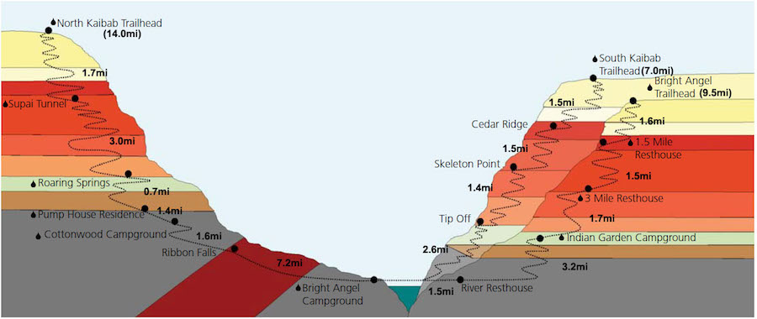
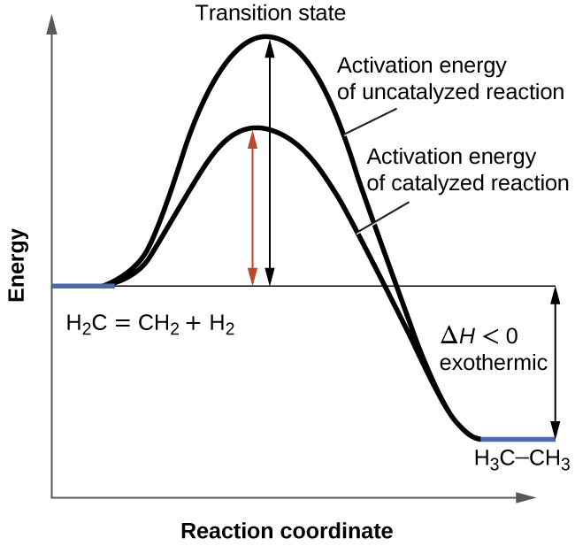
Catalysis
A substance which increases the rate of a chemical reaction
Provides an alternate reaction pathway that has a lower activation energy
Does not affect the energy of reactant or product
North rim
South rim
Reactant
Product
North rim
South rim

Slide 3
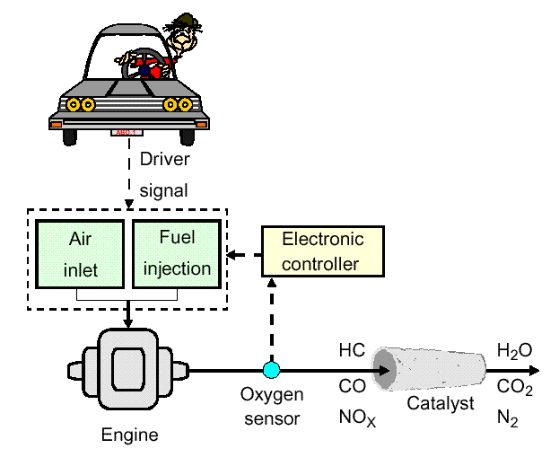
Heterogeneous Catalysis
General Features
Different reaction phases possible: gas/solid; liquid/solid or liquid/liquid systems
In general, wide range of operating conditions (high temperatures/pressures)
Industrial relevance
- Haber-Bosch process: NH₃ production by Fe/Ru catalysts
Operation simplicity (ease of separation of reactants/products/catalysts)
Example from daily life – The three-way catalyst

Slide 4
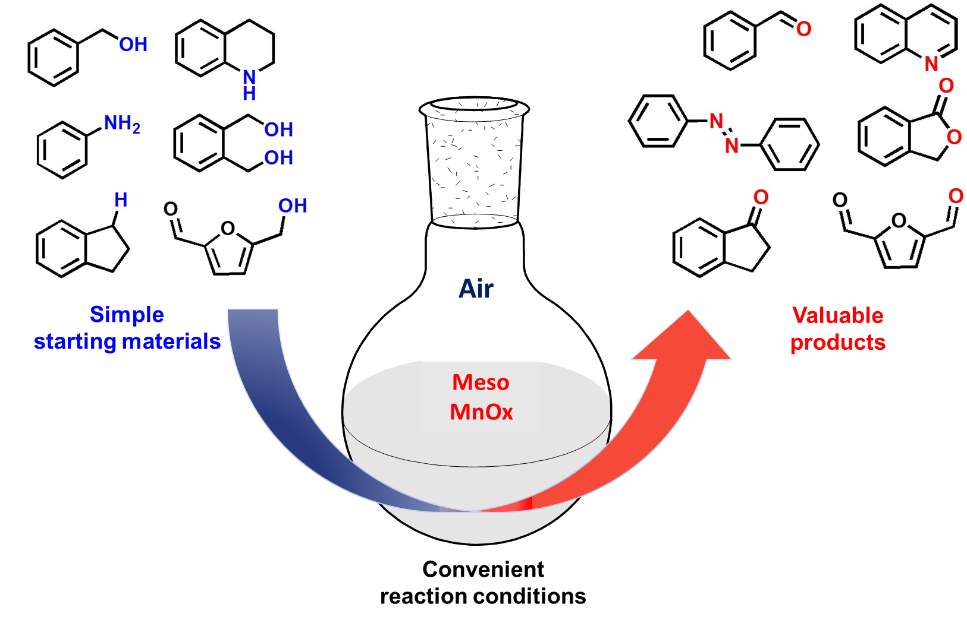
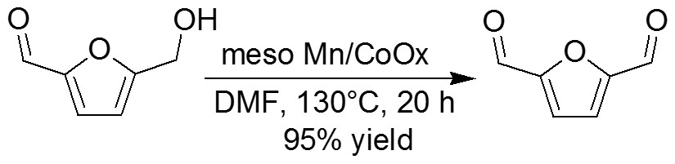
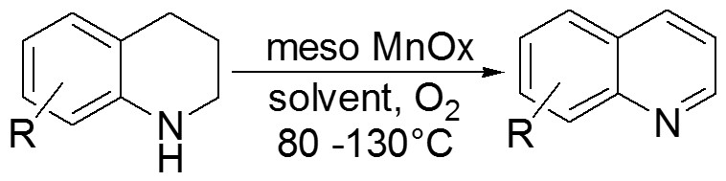
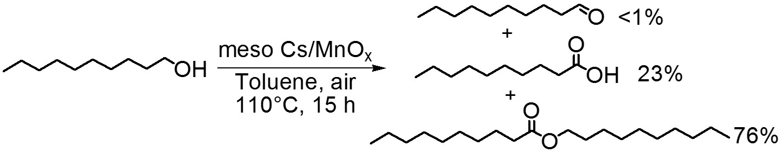
Current Research
Selective oxidation of HMF
HMF
(Biomass-derived)
DFF
(Biopolymer
precursors)
N-H Oxidation
>90% yield
Structural components of major U.S. FDA approved drugs
Oxidative esterification
Cost-effective materials (Mn, Co, Fe)
Robust, thermally stable, and reusable materials
Green and Environmentally benign conditions
  Flavoring agents

