Slide 1
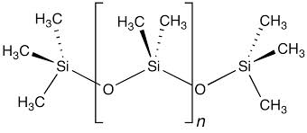
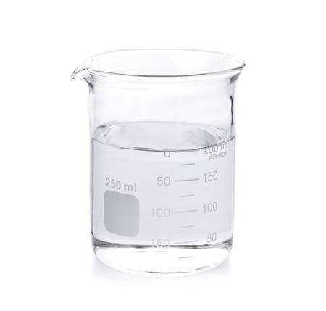
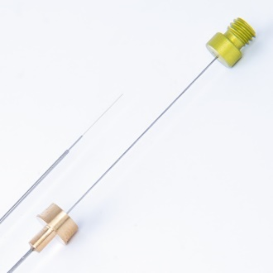
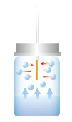
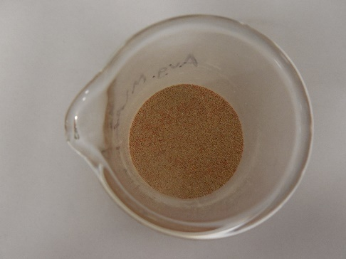
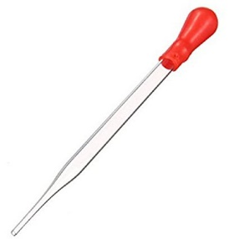
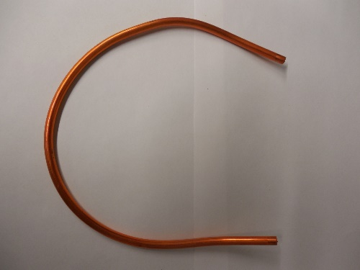
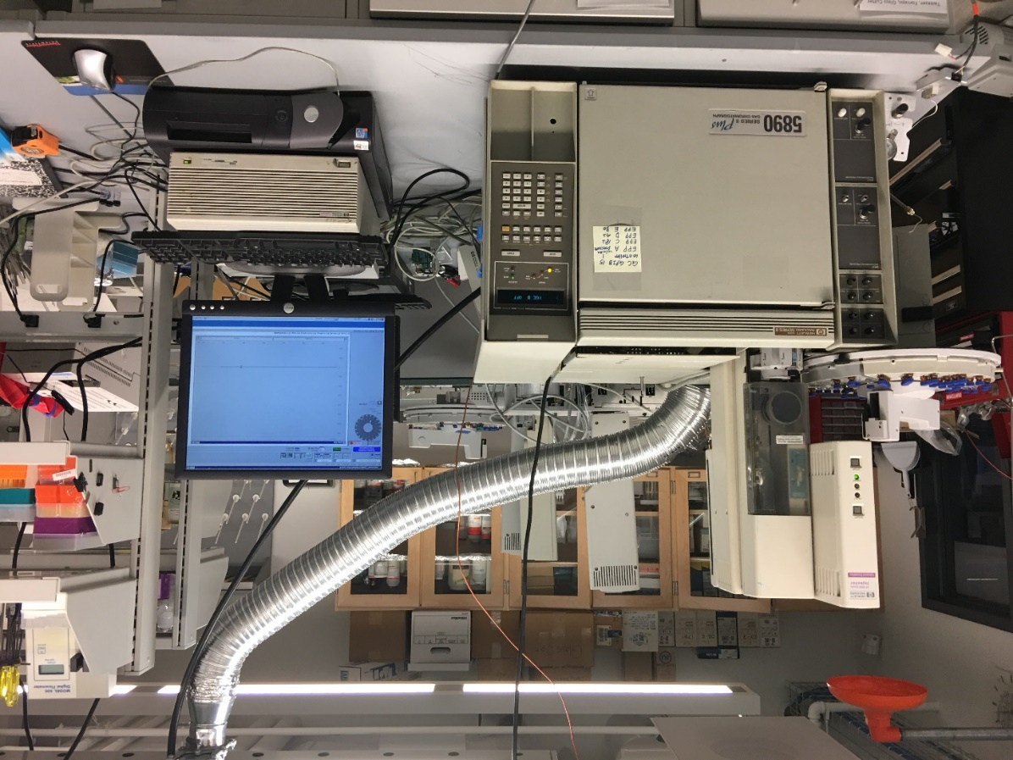
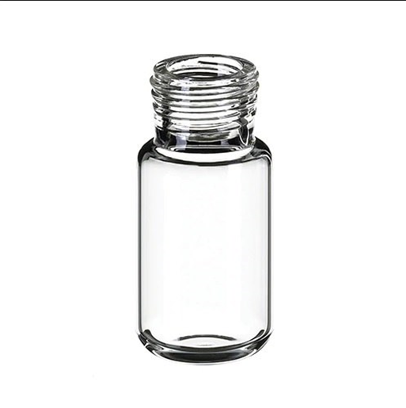
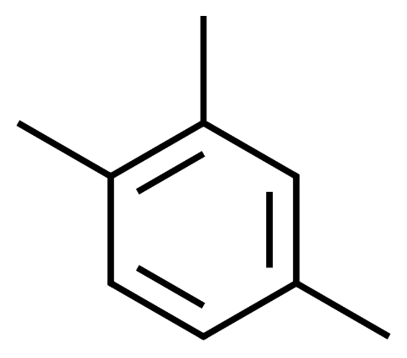
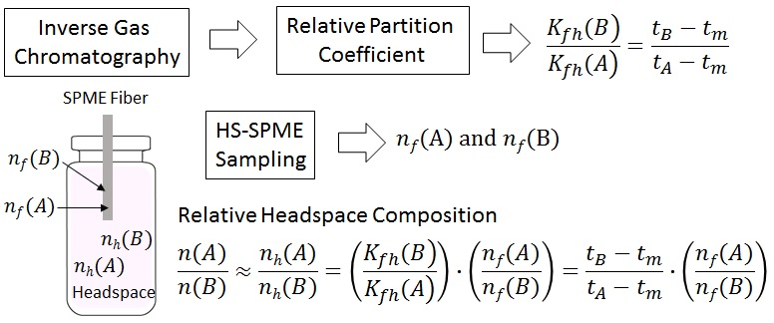
How to Estimate True Compositions of Volatile Compounds in Headspace Determined by Solid Phase Microextraction (HS/SPME)
Jamie Kim
Department of Chemistry, Buffalo State, SUNY
Background and Goals
Experimental
Results
Polydimethylsiloxane (PDMS) based solid phase microextraction (SPME) fibers are commonly used as a sampling tool for various volatile/semi-volatile compounds including gasoline residues via headspace (HS) concentration.
However, the compositions of volatile compounds in headspace (HS) via SPME sampling method usually differ from true compositions mainly because the partition coefficients of these compounds between headspace and a SPME fiber are not equal (K_{fh}).
The estimation of relative compositions of three vaporized hydrocarbons in headspace (HS) using ratios of partition coefficients (K_{fh}) obtained from inverse gas chromatography (IGC) and compare the results to those obtained from direct vapor analysis.
PDMS coating on Chromosorb P and column preparation
HS analysis at 100 °C
Sample | Compounds | PDMS SPME sampling composition | Estimated headspace composition (HS_{calc.}) | Experimental headspace composition (HS_{exp.}) | Relative % error
 | n-heptane | 8.5 (1) | 27.7 (4) | 29.4 (5) | -5.4
1 | toluene | 17.1 (2) | 36.2 (8) | 35.0 (4) | 3.4
 | TMB | 74.4 (2) | 36.1 (1) | 35.7 (9) | 1.1
 | n-heptane | 18.9 (2) | 43.3 (8) | 46.3 (4) | -6.6
2 | toluene | 25.4 (4) | 37.8 (9) | 37.3 (1) | 1.3
 | TMB | 55.7 (6) | 19.0 (2) | 16.4 (3) | 15.5
 | n-heptane | 3.2 (1) | 13.2 (6) | 13.5 (3) | -1.9
3 | toluene | 12.9 (3) | 34.9 (10) | 32.2 (5) | 7.9
 | TMB | 83.9 (4) | 51.9 (3) | 54.2 (9) | -4.3
$$n=\frac{K_{fh}V_{f}C_{0}V_{h}}{K_{fh}V_{f}+V_{h}}$$
C₀: concentration of analyte in a HS
V_{f}: volume of SPME fiber
V_{h} : volume of HS
PDMS (MW ~95,000)
PDMS solution in THF
SPME fiber
HS-SPME sampling
Coating on Chromosorb P
Packing in the copper column
IGC measurements
Probes: n-heptane, toluene, TMB
Carrier Gas: Hydrogen
Flow Rate: 10 mL/min at 25 °C
Injection Volume: 0.01 μL
Inlet Temperature: 280 °C
Oven Temperature: 90 and 130 °C
Detector: Flame ionization detector (FID)
Theory of IGC
HS analysis at 130 °C
Inverse gas chromatography (IGC): measurement of interactions between gaseous solute (mobile phase) and solid (stationary phase), to produce retention volume (V_{N}) at a given temperature (T) and a mass of solid phase (m).
Partition coefficient (K):
Relative partition coefficient (K/K”): relative compositions between analytes in headspace.
Sample | Compounds | PDMS SPME sampling composition | Estimated headspace composition (HS_{calc.}) | Experimental headspace composition (HS_{exp.}) | Relative % error
 | n-heptane | 10.5 (7) | 27.2 (16) | 28.7 (4) | -5.3
1 | toluene | 20.1 (7) | 35.4 (12) | 34.7 (1) | 2.0
 | TMB | 69.4 (14) | 37.4 (7) | 36.6 (5) | 2.2
 | n-heptane | 23.3 (8) | 43.6 (16) | 46.1 (3) | -5.4
2 | toluene | 29.9 (1) | 38.1 (3) | 37.0 (1) | 2.9
 | TMB | 46.8 (10) | 18.3 (4) | 16.9 (2) | 8.2
 | n-heptane | 3.7 (2) | 12.2 (7) | 13.2 (3) | -7.9
3 | toluene | 14.8 (5) | 32.7 (10) | 31.9 (5) | 2.7
 | TMB | 81.5 (7) | 55.1 (4) | 54.9 (7) | 0.3
probe molecule
injection
$t$_{m}
CH₄
$t$ - tm
$$V_{N}=J∙F∙\left(t−t_{m}\right)$$
t: retention time of a probe
t_{m}: retention time of a marker
F: flowrate
J: correction factor
Preparation of headspace with different compositions for PDMS SPME and direct vapor analysis
gas
Adsorption-desorption
elution
$$signal (a.u.)$$
stationary phase
$$detection$$
$$probe$$
column packed with a material of interest
$$time (s)$$
V_{s}: volume of stationary phase
m: mass of stationary phase ρ: density of stationary phase
T: column temperature
$V_{g}^{°}$: specific retention volume
n-heptane (x)
toluene (y)
1,2,4-trimethylbenzene (z)
Headspace vial
(10 mL)
$$K_{p}=\frac{V_{N}}{V_{s}}=V_{g}^{o}∙\frac{T}{273.15}∙\frac{m}{V_{s}}=V_{g}^{o}∙\frac{T}{273.15}∙ρ$$
Relative partition coefficient at 100 and 130 °C via IGC Measurements
 | Temperature (°C)
 | 100 | 130
K_{fh}(toluene)/K_{fh}(n-heptane) | 1.54 (1) | 1.47 (1)
K_{fh}(TMB)/K_{fh}(n-heptane) | 6.72 (9) | 4.81 (3)
Summary and Future Plan
Experimental Strategies
Estimated headspace chemical compositions (from SPME sampling and partition coefficients) are comparable to true compositions via a direct headspace vapor injection method.
Partition coefficients via IGC measurements using capillary columns (DB1 phase) will be estimated.
Headspace containing more and various volatile compounds will be tested.
ACKNOWLEDGEMENTS
Office of Undergraduate Research
Chemistry Department
References
Kim, J.; Schmitz, M.; Al-Saigh, Z. Y., Application of Inverse Gas Chromatography for Quantitative Chemical Analysis of Volatile Compounds via Headspace-Solid Phase Microextraction, Forensic Chem. 2018, 11, 7-14.

