Slide 1
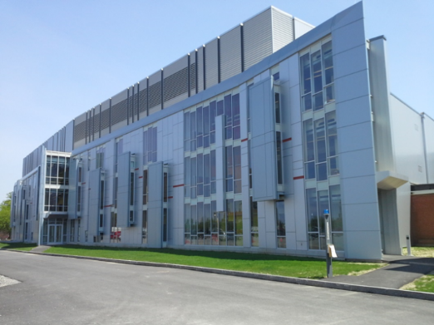
Application of quantum crystallography methods to structures of macrocyclic 3d-transition metal complexes
Alexander Y Nazarenko
State University of New York
College at Buffalo
nazareay@buffalostate.edu

Slide 2
Application of quantum crystallography methods to structures of macrocyclic 3d-transition metal complexes
Usual X-ray crystal structures: Independent Atom Model (IAM):
all atoms are spherical. No chemical features (bonds, ions, lone pairs) exist.
Shocking for a chemist!
Quantum Crystallography: Same or better X-ray diffraction data are interactively
combined with DFT or HF calculations: molecular dynamics data for vibrations and
Spectroscopy information could be potentially added
X-ray crystallography
Quantum Crystallography
Real electron density
Quantum chemistry
Dynamics (vibrations, rotations,…)
Spectroscopy Data
…not yet

Slide 3
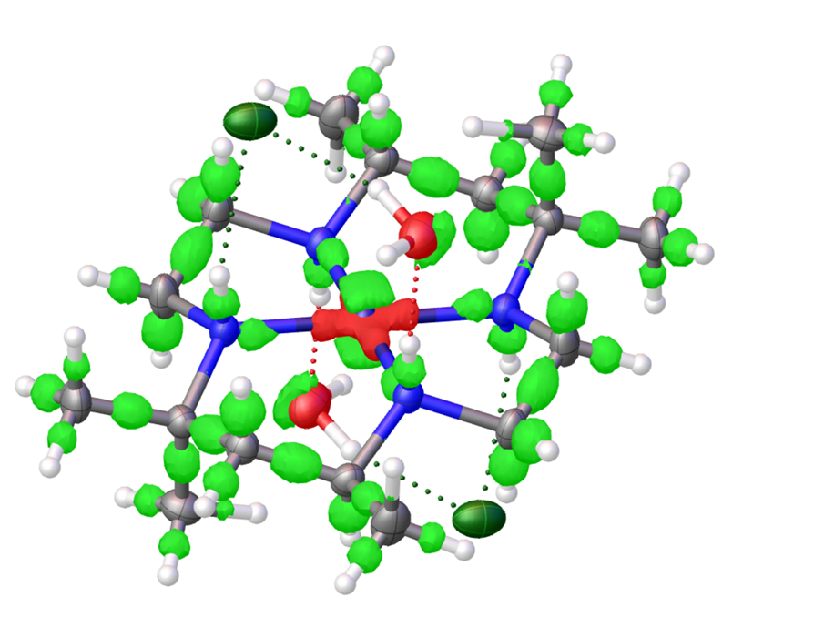
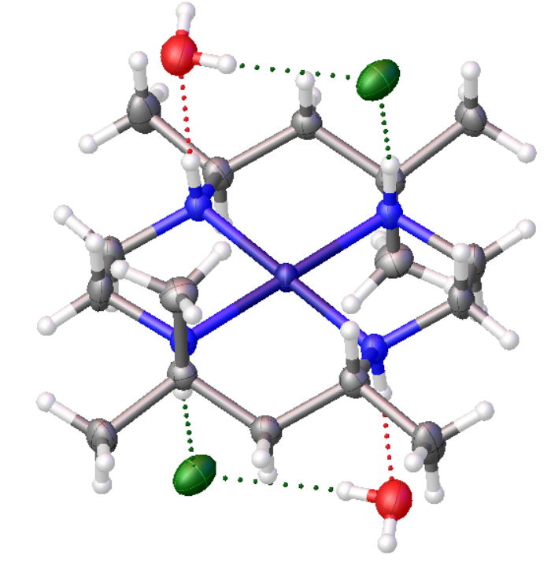
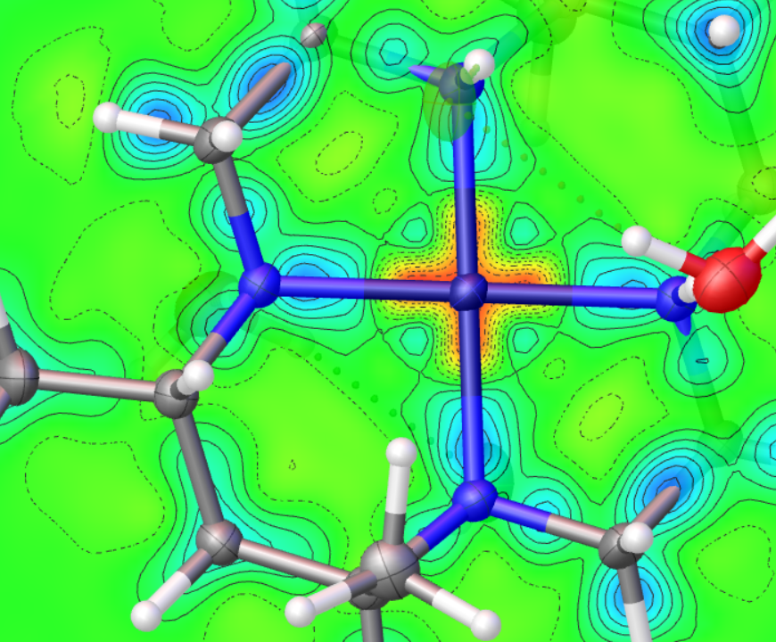
Application of quantum crystallography methods to structures of macrocyclic 3d-transition metal complexes
IAM
IAS NoSpherA2 HARt
R
σ(C-C)×10⁻⁴Å
3.69 3.40 3.16 2.99
20 15÷17 14÷15 13
Ni d⁸

Slide 4
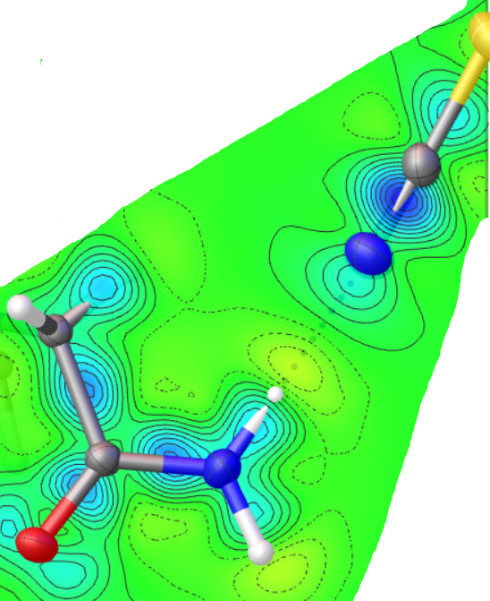
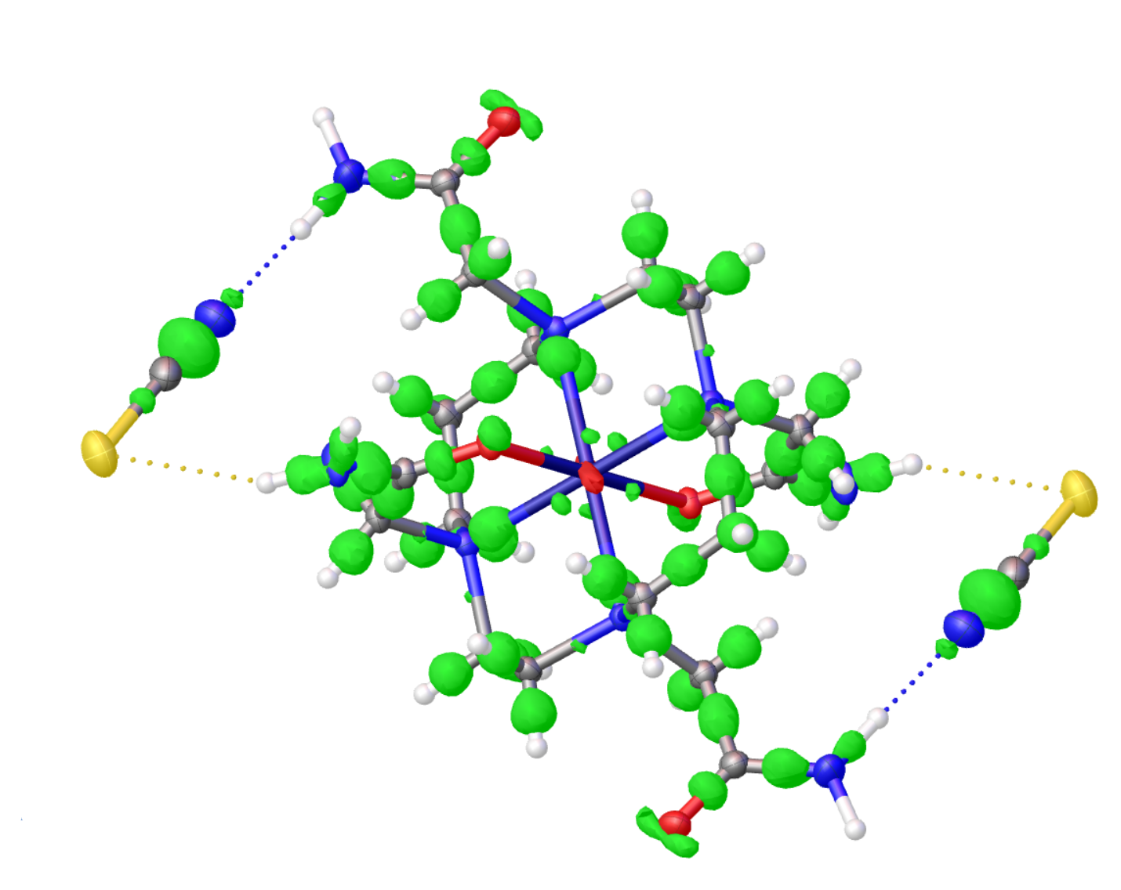
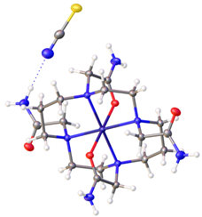
Application of quantum crystallography methods to structures of macrocyclic 3d-transition metal complexes
IAM
IAS NoSpherA2
R
σ(C-C)×10⁻⁴Å
2.93 2.49 2.17
13÷16 11÷13 11
Co d⁷

