Slide 1
Electro-Optical Effects in YbFe₂O₄ Thin Films
Ram Rai, Ph.D.
Professor
Department of Physics
SNSS, Buffalo State college
Faculty and Staff Research and Creativity Forum Spring 2021
Abstract: YbFe₂O₄ shows interesting physical properties mainly due to its triangular lattice structure occupied by the equal number of Fe²⁺ and Fe³⁺ ions. Here, we present the optical and electro-optical properties of YbFe₂O₄ thin films. The electronic excitations in YbFe₂O₄ display strong temperature dependence and these excitations can also be modified by applied electric fields. The field-induced changes in optical properties (up to ~10%) vary almost linearly with applied electric fields at low temperatures, but they disappear above 120 K. The observed electro-optical effects can be interpreted as the effects of external electric fields on the orbital-charge ordering of Fe ions.

Slide 2
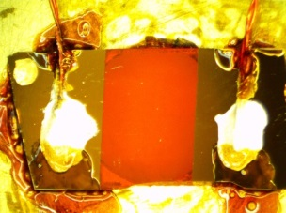
Electro-Optical Effects in YbFe₂O₄ Thin Films
YbFe₂O₄ (YbFO) has a rhombohedral structure and the following characteristics:
FeO₅ bipyramids are the building block
Equal number of Fe²⁺ and Fe³⁺ ions
Spin and charge frustrations in the system, leading to interesting physical properties
Ferrimagnetic transition at ~240 K
Structural transition at ~180 K
The orbital charge ordering is expected to produce ferroelectricity, thus it is believed to be “multiferroic”
R
O
Fe
Figure 1: The x-ray diffraction pattern of 120 nm YbFe₂O₄ thin film, deposited by electron-beam deposition, on (111) YSZ at 850 ºC. As shown, multiple planes of YbFO were observed.
The image at the top represents the YbFO film with two electrodes attached for the electro-optical measurements.
Optical spectroscopy was used to investigate the optical properties and electro-optical effects of YbFe₂O₄/YSZ thin films in the temperature range 10 - 300 K.

Slide 3
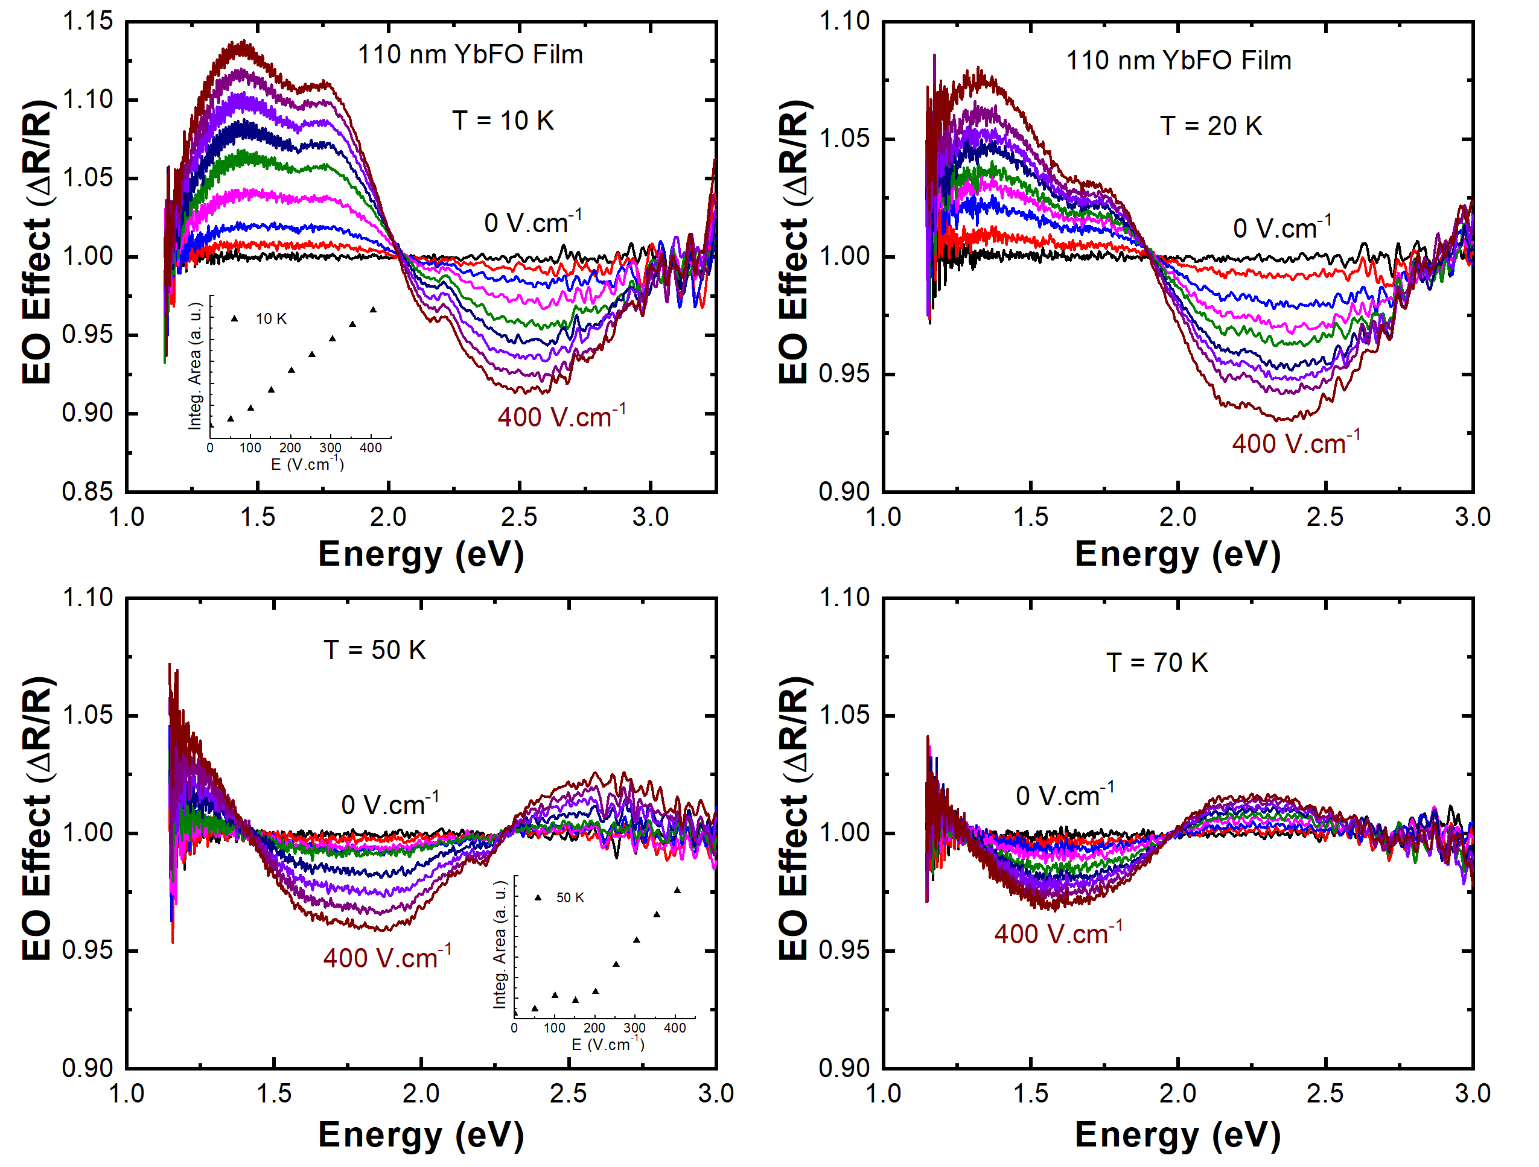
Electro-Optical Effects in YbFe₂O₄ Thin Films
Figure 2: The electro-optical (EO) effects of YbFO at 10, 20, 50, and 70 K, respectively. The strongest EO effects were observed at 10 K and vary from +14% to -9%. The effects decrease as the sample temperature increases and completely disappears around 120 K.
The EO effects:
vary linearly with the field
located between 1.25 and 3 eV (where Fe d to d electronic excitations are located.)

Slide 4
Electro-Optical Effects in YbFe₂O₄ Thin Films
The EO effects are defined as:
$$Where R is the reflectance signal and E is the applied$$
$$electric field$$
$$\frac{ΔR}{R}=\frac{R(E)−R(E=0)}{R(E=0)}$$
What causes the EO effects in YbFO?
The energy locations of the EO effects offer insight into the mechanism.
Possible Mechanism:
Applied electric fields could cause
distortions of the FeO₅ bipyramids, directly affecting the Fe d electronic states.
the band bending at the metal-insulator interface, affecting the energy band gap of YbFO.
Conclusion: YbFe₂O₄ shows unique EO effects possibly associated with its Fe charge ordering.
Figure 3: Absorption coefficient of ~120 nm YbFO thin film at room temperature. As indicated, two electronic excitations at ~2.0 eV and 2.45 eV are located where the EO effects were observed.

