Slide 1
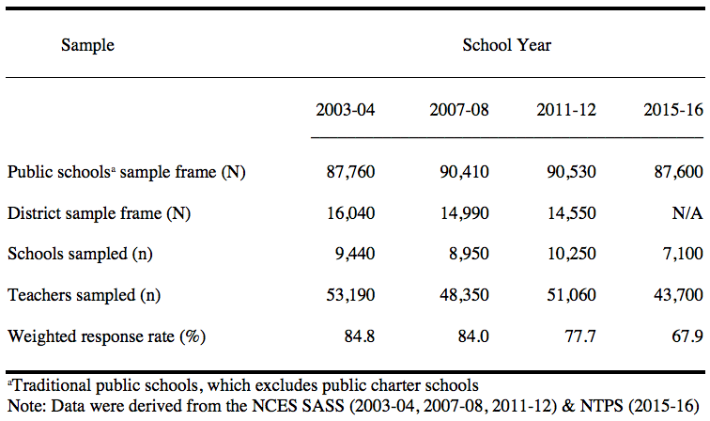
Identifying Academic Majors and Certifications of Health Teachers in the United States
Authors
Results (data from NCES SASS & NTPS, 2003-2016)
Catherine Cardina, Ph.D.
Associate Professor
Leah Panek-Shirley, Ph.D.
Assistant Professor
Department. of Health Nutrition & Dietetics
Academic Majors of Health Teachers (%)
Poster Objective
Identify current trends related to health education teacher certification and academic major among staff teaching health education in the United States.
Introduction
As stated by the CDC (2018), health education, when provided by qualified, trained teachers, helps students attain the knowledge, attitudes, and skills needed to make healthful decisions, achieve health literacy, and advocate for the health of others. Qualified trained teachers, often synonymous with quality teachers, provide students with the necessary formal and structured health education instruction. Two widely used standards that describe quality teachers are demonstrated subject-matter competency (i.e. passing a subject knowledge test or having a baccalaureate degree or better in the subject) and full state teacher certification or licensure in the area they teach. Current research supports the relationship between teachers’ subject area knowledge and certification as they contribute to student academic achievement (Darling-Hammond, 2006; Elfers et al., 2004; Ingersoll, 2002; U.S. Department of Education, 2015).
Certifications of Health Teachers (%)
Purpose of Study
Conclusions
The purpose of this study is to identify trends in academic majors and subject-area certifications, licensures, or endorsements of K-12 public school staff in the United States who were teaching health education during this century. Specifically, what percent of health education teachers had an academic major in health education teachers per school year? Secondly, what percent of health education teachers were certified, licensed, or endorsed in health education?
Finds show an increase of PE teachers and dual certified P/HE teachers serving as health teachers. Until the last data collection during 2015-16, more health teachers had an academic major health than physical education. The last data collection showed health teachers were more likely to have an academic major on PE. In general, students in the U. S. during the 21st century were not taught health education by quality or qualified K-12 health education teachers who had an academic major and certification in health education.
Methods
Data for this study were extracted from four consecutive administrations (years 2003-04, 2007-08, 2011-12, & 2015-16)of the Schools and Staffing Survey (SASS) (years 2003-04, 2007-08, 2011-12, & 2015-16), which is currently named the National Teacher and Principal Survey (NTPS). The SASS and NTPS are nationally representative surveys of school employees in the United States, conducted regularly by the National Center for Educational Statistics (NCES) of the U.S. Department of Education (NCES n.d.). Teachers’ responses to questions about their education and certification were included in this study. The most current 21st-century data available from NCES were used for this study. Participants: Teachers were defined as staff members in United States traditional public, non-charter schools who taught students in any of the school grades K–12. Teachers were included in this study on the basis of their teaching at least one class of health education during any of the four time slices under study. Instruments: The SASS and NTPS Teacher Questionnaires consisted of multiple sections (NCES, n.d.). For this study, questions pertaining to education and certification were used. Education was assessed by responses to items that asked teachers to list major fields of study for their baccalaureate degrees, advanced degrees (master’s and doctorate), and educational specialist degrees. Teachers were also asked to self-report their state certifications, licenses, and endorsements. Procedure: The objective of the SASS/NTPS survey sampling method was to produce a sample that could be generalized to represent the population of U.S. public school teachers as a whole. For each year of data collection, the NCES has designed the weights and sample methodologies to support longitudinal analysis. Data Analysis: Descriptive statistics were used to identify the weighted frequencies of teachers’ academic majors and subject-area certifications. Tables and discussion in this poster used these weighted data for the presentation of frequencies and calculation of percentages along with the upper and lower boundaries of 95% confidence interval as obtained using the weighted analysis techniques described above.
Recommendations
Encourage principals, administrators, and school boards of education to hire qualified health education teachers
Include certifications and academic majors of health education teachers in state and federal accountability reporting systems (i.e. school report cards)
Require an academic major in health education for teacher certification, licensure, or endorsement that includes pedagogical knowledge, health content knowledge, health pedagogical content knowledge.
Establish Health People 2030 goals to that aim to increase the proportion of schools that require newly hired staff who teach health education to have an undergraduate or a graduate degree (not simply “training”) in health education
Encourage collaboration between state departments of education and institutions of higher education to establish academic majors in health education to meet the staffing needs of school districts for qualified health education teachers.
Promote the message that health education, when taught by qualified health teachers, provides youth with the knowledge and skills to practice healthy behaviors and reduce health risk behaviors, which positively affects students’ academic performance.
Study Sample
References
*Darling-Hammond, L. (2006), “Constructing 21st-century teacher education”, Journal of Teacher Education, Vol. 57 No. 3, pp.300-314. DOI:10.1177/0022487105285962 *Elfers, A.M., Knapp, M.S. and Pleck, M.L. (2004), “Preparation and support for teaching: a survey of teachers’ assignment and certification”, available at: https://www.education.uw.edu/ctp/sites/default/files/ctpmail/PDFs/Survey1WorkingPaper.pdf (accessed 10 August 2020). *National Center for Educational Statistics (n.d.), “National teacher and principal survey (NTPS)”, available at: https://nces.ed.gov/surveys/ntps/index.asp (accessed 10 August 2020). *U.S. Department of Education. (2015). “Highly-qualified teacher data: summary of school year 2013-2014 data”, available at: https://www2.ed.gov/programs/teacherqual/hqtreport.pdf (accessed 27 July 2020).

