Slide 1
Erie County Low Income Project for Sustainable Energy (ECLIPSE): Dashboard Design
Alan M. Delmerico, PhD
Scott Martin &
John Petrocelli
Center for Health and Social Research
School of Natural and Social Sciences
SUNY Buffalo State

Slide 2
Erie County Low Income Program for Sustainable Energy (ECLIPSE)
Background
NYSERDA
Cleaner Greener Communities
Collaborative effort of government (Erie County) and academia (Buffalo State)
Simultaneously lower greenhouse gas emissions and improve the energy burden of disparate populations
Social Determinants of Health

Slide 3
Big Picture – What’s the big problem
Home Energy Affordability Gap
Fisher, Sheehan & Colton, April 2016

Slide 4
Data, Dashboards, Evaluation
Guided exploration of the data
Dashboard featuring Key Performance Indicators (KPIs) for the project
Visualizations including interactive web mapping to allow exploration of data elements
Make data useful!
We can’t robustly test the outcomes
Align data to help us understand the contribution of the program’s efforts to changing the outcomes
Prioritize disparate populations, including by geography
Identify gaps and barriers in programs/systems
Indicate areas where stakeholders may pursue future funding for programming

Slide 5
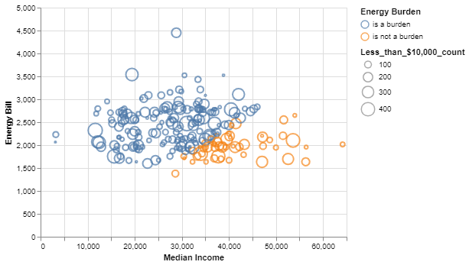
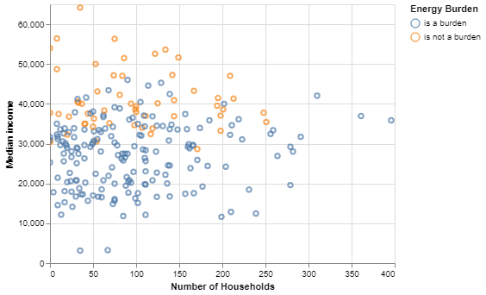
Python Data Visualization Examples

Slide 6
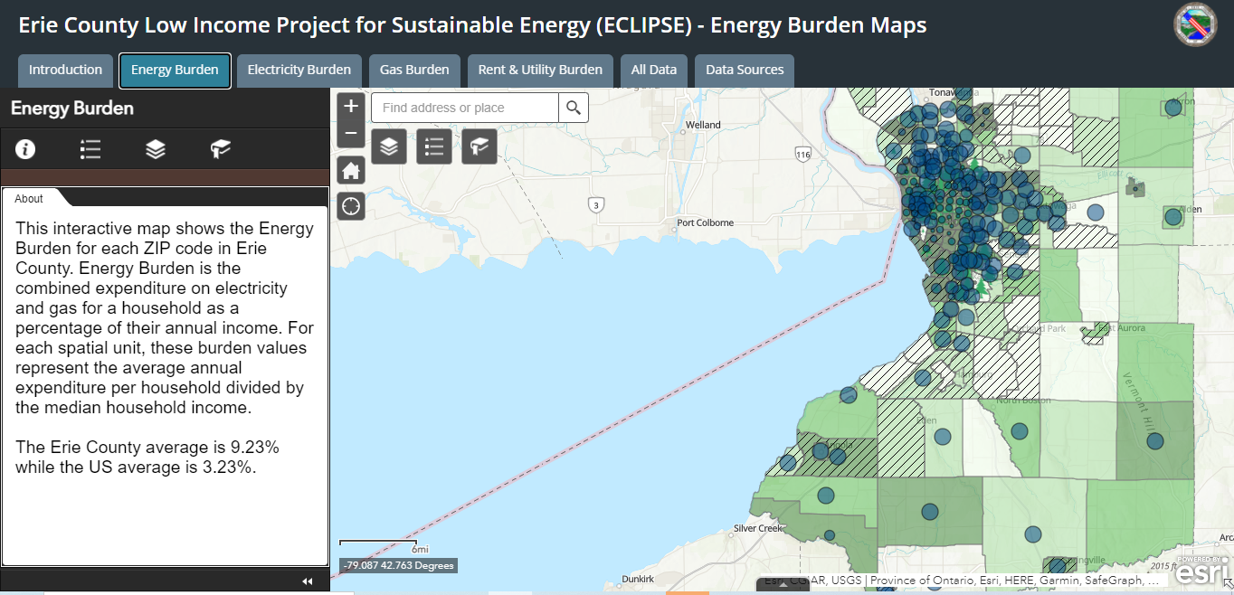
Energy Burden Maps

