Slide 1
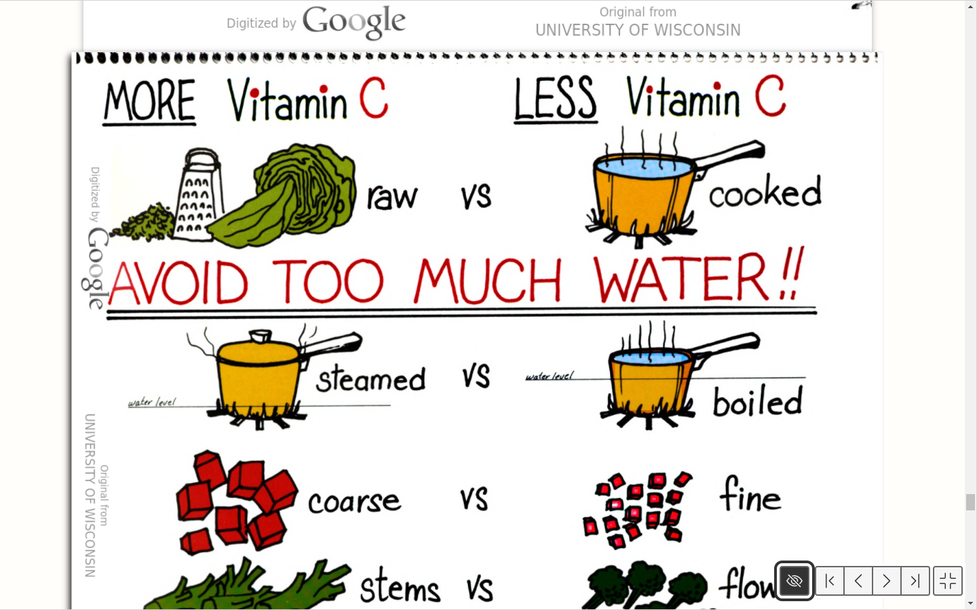
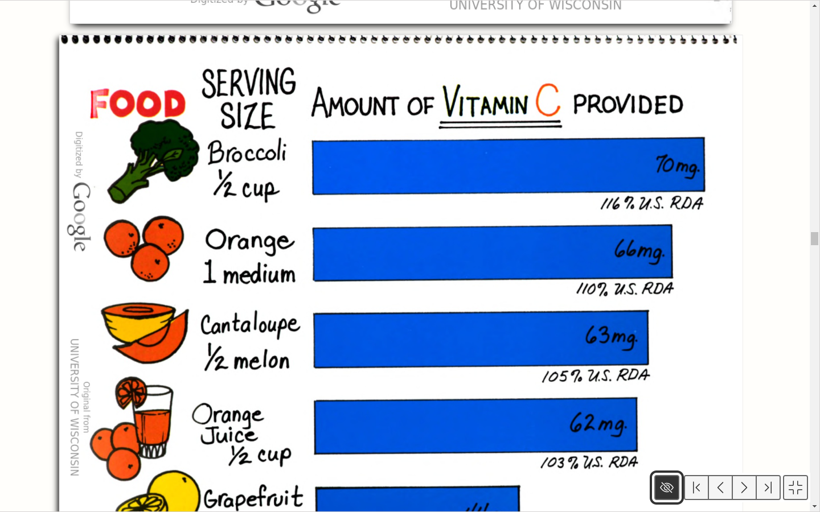
Food For Vitamin C
Aden Yakub, History, 300W
Background
Survey From 1965
How to get the most Vitamin C?
A survey conducted in 1965 focused on Household Food consumption is shown below. The survey illustrated the contribution of different food groups that were consumed for Vitamin C. Fruits and Vegetables were the highest percentage at 87%, while dairy products were at 5%, finally meat and grain were tied at 4%. As Jane Voichick and Marcia state Vitamin C is mostly found in fruits and vegetables, It was no surprise it was the highest food consumed for Vitamin C.
The data shown was made possible by Marcia Griffith and Jane Voichick. Marcia Griffith was a research assistant and Jane Voichick was an assistant professor of Nutritional Science.
Griffiths and Voichick emphasize the significance of food preparation when it comes to food with Vitamin C. As stated by Griffiths and Voichick Vitamin C is water soluble , during food preparation if the food is washed for too long, Vitamin can be lost.
Introduction
Some researchers including Jane Voichick and Marcia Griffith believed Vitamin C is a significant component to the American diet. Maria Griffith and Jane Voichick state Vitamin C has a lot of benefits such as build strong bones and help strengthen blood vessels and other tissues in the body. According to Jane Voichick and Marcia Griffith lack of Vitamin C can cause tired feeling and the prolonged effect is it can cause gums to bleed.
Conclusion
Fruits and Vegetables have been shown to provide the most Vitamin C. As shown in the 1965 Household consumption Survey, fruits and vegetables such as broccoli and orange can provide most of the recommended daily allowance of Vitamin C. It is also important to know how to prepare food rich in Vitamin C as it can affect the amount of Vitamin C received.
Serving Size
.
Reference
Griffiths, Marcia, Jane Voichick, and University of Wisconsin--Extension. Cooperative Extension Programs. Key Nutrients And Health. Vitamin C. Madison, Wis.: University of Wisconsin--Extension, 1975.
For all images see:
Griffiths, Marcia, Jane Voichick, and University of Wisconsin--Extension. Cooperative Extension Programs. Key Nutrients And Health. Vitamin C. Madison, Wis.: University of Wisconsin--Extension, 1975.
The amount of Vitamin C some food provide are shown on this graph. A half cup of broccoli would provide 70 Mg of Vitamin C, while a medium orange would provide 66 mg of Vitamin C. All these foods shown here provide most of the RDA, the recommended daily allowance in the U.S.

